Slide 1

Project Phase - I

Slide 2
YouTube Video Content Analysis and Summarization Automation
Team Members Panel Number: 5
Project Advisor: Ms. Sasikala T | CSE
S.No | Registration Number | Student Name | Section
1 | BL.EN.U4CSE17523 | T V Premchand | C
2 | BL.EN.U4CSE17524 | Y V Sravan Kumar Reddy | C
3 | BL.EN.U4CSE17551 | T Yeswanth Sai | C

Slide 3
Index
Motivation
Problem Statement
Proposed Solution
Tools and Technologies
Input and Output
Work Plan
Details Extracted
References
History of Algorithms used

Slide 4
Motivation
YouTube, one of the most significant online video sharing and streaming applications. We spend some noticeable amount of our time watching YouTube videos every single day, be it for education, sports, entertainment, or exploring our interests. Moreover, we know that we are watching it for information. We want to develop a software program that automates the process of information extraction from a video and of the video.

Slide 5
Problem Statement
To develop a software program that will allow the user to save his/her time and improve efficiency in information extraction from an unstructured data source.
Unstructured Data Source: YouTube

Slide 6
Proposed Solution
The software program will take the YouTube video link of the user’s choice as input. And there are two types of content we are going to extract as; one is the summarized text content from the video using Natural Language Processing, and the second form of content is details of the YouTube video like; the name of the video, views count, the category under which the video had shared, etc. using web scraping process. This allows the user to save his time and improve efficiency in information extraction from an unstructured data source.

Slide 7
Tools and Technologies
Python modules and libraries:
BeautifulSoup
Contextlib
OS
Selenium
Speech Recognition
Time
Wave
Youtube_dl
Automation:
Selenium (Python module)
Chrome Web-driver

Slide 8
Input and Output
Input:
YouTube video link
Output:
YouTube video details extracted along with summarized text content from the YouTube video

Slide 9
Work Plan
Video Title
Duration
Published Date
Description
Views Count
Likes Count
Dislikes Count
Channel Name
Location
Video Details
Output
Video Link
Summary
Video Content

Slide 10
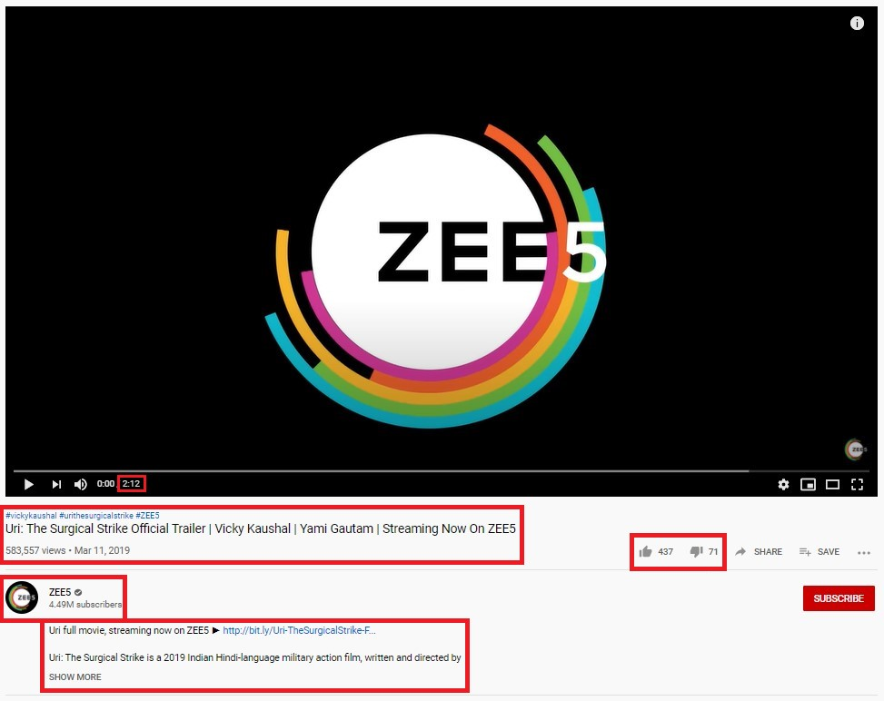
Details Extracted
Video Title
Duration
Published Date
Description
Views Count
Likes Count
Dislikes Count
Channel Name
Location

Slide 11
References
Robin, J., 1994. Revision-based generation of natural language summaries providing historical background: corpus-based analysis, design, and implementation. Ph.D. Thesis, Columbia University.
Web Scraping with Python -- collecting data from the modern web by Ryan Mitchell
Salton, G., Singhal, A., Mitra, M., and Buckley, C. 1997. Automatic Text Structuring and Summarization. Information Processing and Management, 33(2), 193-207. Reprinted in Mani, I., and Maybury, M., eds., Advances in Automatic Text Summarization, MIT Press, pp. 341-355.
Sparck-Jones, K., and Galliers, J., 1996. Evaluating Natural Language Processing Systems: An Analysis and Review. Lecture Notes in Artificial Intelligence 1083. Springer-Verlag
Munzert, Simon. Automated Data Collection with R: A Practical Guide to Web Scraping and Text Mining. Chichester, West Sussex, United Kingdom: John Wiley & Sons Inc, 2015.

Slide 12
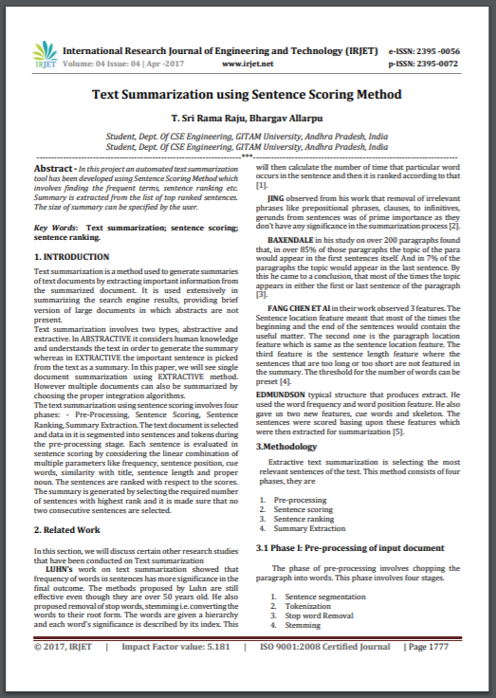
References
Text Summarization using Sentence Ranking Algorithm
https://www.irjet.net/archives/V6/i4/IRJET-V6I4564.pdf

Slide 13
History of Sentence Scoring/Ranking Algorithm

Slide 14
Word Sense Disambiguation
Sense ambiguity:
Many words have several senses.
Word “bass” have different meanings according to context as given in the below example.
An electric guitar and bass player stand off to one side, not really part of the scene, just as a sort of nod to gringo expectations perhaps.
And it all started when fisherman decided the striped bass in Lake Mead were too skinny.

Slide 15
Algorithms for Word Sense Disambiguation
Knowledge based approaches
Overlap based approach
Machine learning based approaches
Supervised approaches
Semi-supervised approaches
Unsupervised approaches
Hybrid approaches

Slide 16
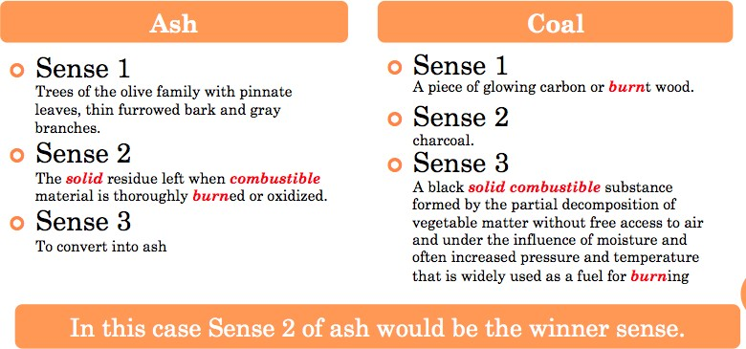
Algorithms for Word Sense Disambiguation
Overlap based approaches:
Requires a Machine Readable Dictionary (MRD).
Find the overlap between the features of different senses of an ambiguous word and features of the words in its context.
Sense bag => Ambiguous words
Context bag => Context words
“On burning coal we get ash”
Lesk’s algorithm

Slide 17
Algorithms for Word Sense Disambiguation
 | Sense-1: Finance | Sense-2: Location
Money | +1 | 0
Interest | +1 | 0
Annum | +1 | 0
Fetch | 0 | 0
Total | +3 | 0
Walker’s algorithm:
A Thesaurus Based approach
Step 1: For each sense of the target word find the thesaurus category to which that sense belongs
Step 2: Calculate the score for each sense by using the context words. A context word will add 1 to the score of the sense if the thesaurus category of the word matches that of the sense.
E.g. The money in this bank fetches an interest of 8% per annum
Target word: bank
Clue words from the context: money, interest, annum, fetch

Slide 18
Algorithms for Word Sense Disambiguation
Difficulties:
For disambiguating the sense of a particular word we are not disambiguating the sense of the other context words.
There will be problem if there are multiple ambiguous words in the same sentence and you want to disambiguate each of them together.

Slide 19
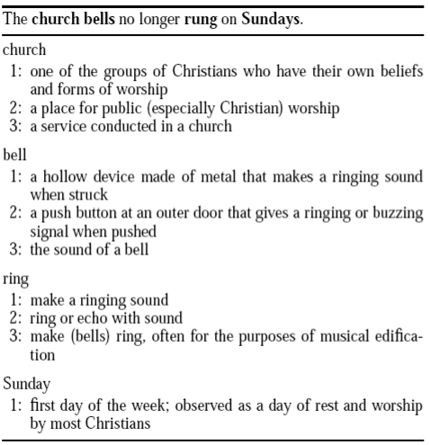
WSD using Random Walk Algorithm

Slide 20
WSD using Random Walk Algorithm
S3
S3
S3
S2
S2
S2
S1
S1
S1
S1
BELL RING CHURCH SUNDAY

Slide 21
WSD using Random Walk Algorithm
Paper that is specially prepared for using drafting
The art of transferring designs from specially prepared paper to a wood or glass or metal surface

Slide 22
WSD using Random Walk Algorithm
0.46
0.97
0.42
S3
S3
S3
0.49
0.35
0.63
S2
S2
S2
0.92
0.56
0.58
0.67
S1
S1
S1
S1
BELL RING CHURCH SUNDAY

Slide 23
WSD using Random Walk Algorithm
Graph Based Ranking Algorithm
0.46
0.97
0.42
S3
S3
S3
0.49
0.35
0.63
S2
S2
S2
0.92
0.56
0.58
0.67
S1
S1
S1
S1
BELL RING CHURCH SUNDAY

Slide 24
Page Rank Algorithm
1
1/3
3
1
0
0
1
1/2
1/3
0
0
0
1/3
A =
1/3
1/2
1/2
1/3
1/2
0
1/2
1/2
2
4
1/3
1/2
0
0
1/2

Slide 25
Page Rank Algorithm
Suppose that initially the importance is uniformly distributed among the 4 nodes, each getting ¼. Denote by v the initial rank vector, having all entries equal to ¼.
We can iterate the process, thus at step 2, the updated importance vector is v₂ = A(Av) = A²v.

Slide 26
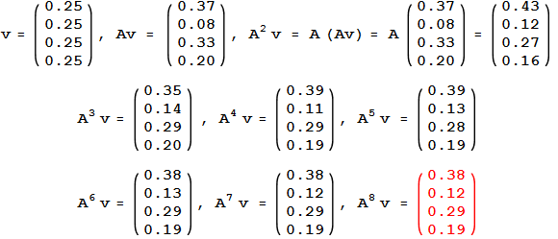
Page Rank Algorithm
Page rank

Slide 27
WSD using Random Walk Algorithm
0.46
0.97
0.42
S3
S3
S3
0.49
0.35
0.63
S2
S2
S2
0.92
0.56
0.58
0.67
S1
S1
S1
S1
BELL RING CHURCH SUNDAY

Slide 28
Sentence Ranking Algorithm
Articles
Text
Sentences
Vectors
Summary
Sentence Ranking
Graphs
Similarity Matrix

Slide 29
Thank you!

